Slide 1
Testing
Instructor: Mehroze Khan

Slide 2
Software Faults and Failures Why Does Software Fail?
Wrong requirement: not what the customer wants
Missing requirement
Requirement impossible to implement
Faulty design
Faulty code
Improperly implemented design

Slide 3

Objective of Testing
Objective of testing: discover faults
A test is successful only when a fault is discovered
Fault identification is the process of determining what fault caused the failure
Fault correction is the process of making changes to the system so that the faults are removed

Slide 4
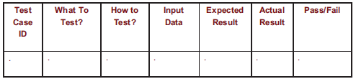
Elements of a Test Case
Purpose
Input
Expected Output
Actual Output
Sample Format:

Slide 5
Types of Faults
Algorithmic fault
When a component’s algorithm or logic does not produce the proper output for a given input because something is wrong with the processing steps
These faults are sometimes easy to spot just by reading through the program (called desk checking) or by submitting input data from each of the different classes of data that we expect the program to receive during its regular working
Typical algorithmic faults include:
branching too soon
branching too late
testing for the wrong condition
forgetting to initialize variables or set loop invariants
forgetting to test for a particular condition (e.g., when division by zero might occur)
comparing variables of inappropriate data types

Slide 6
Types of Faults
Syntax fault
Computation and precision fault
A formula’s implementation is wrong or does not compute result to required number of decimal places
Documentation fault
Documentation doesn’t match what program does
Capacity or boundary faults
System’s performance not acceptable when certain limits are reached
Timing or coordination faults
Occur when the code coordinating several processes executing simultaneously or in a carefully defined sequence is inadequate
Throughput or performance faults
System does not perform at the speed prescribed by requirements

Slide 7
Different Level of Failure Severity
Catastrophic: causes death or system loss
Critical: causes severe injury or major system damage
Marginal: causes minor injury or minor system damage
Minor: causes no injury or system damage

Slide 8
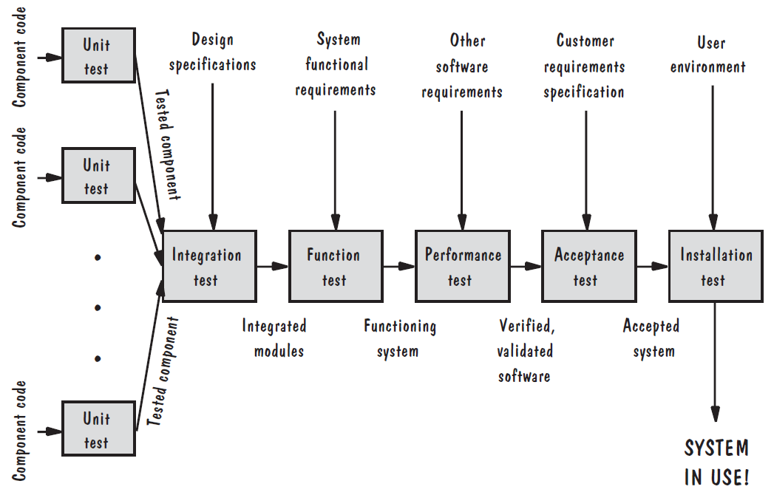
Testing Steps

Slide 9
Testing Issues Attitude Toward Testing
Programs are viewed as components of a larger system, not as the property of those who wrote them

Slide 10
Testing Issues Who Performs the Test?
Independent test team
avoid conflict
personal responsibility vs need to discover faults
improve objectivity
allow testing and coding concurrently

Slide 11
Testing Issues Views of the Test Objects
If we view the test object from the outside as a closed box or black box whose contents are unknown, our testing feeds input to the closed box and notes what output is produced
Test’s goal is to be sure that every kind of input is submitted, and that the output observed matches the output expected
Open box (sometimes called clear box or white box); can use the structure of the test object to test in different ways
Devise test cases that execute all the statements or all the control paths within the component(s) to be sure the test object is working properly

Slide 12
Testing Issues Views of the Test Objects
Closed box or black box: functionality of the test objects
Equivalence Class, Boundary Value Analysis, Scenario-based, Decision Table based, State Machine based…
Clear box or white box: structure of the test objects
Control Flow
Basis Path, Branch, Statement, Decision…
Data Flow
Du Path, All-uses Path

Slide 13
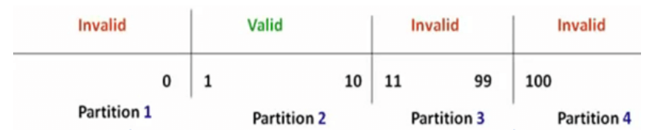
Black Box Testing Equivalence Class Partitioning
In this technique, input data units are divided into equivalent partitions that can be used to derive test cases which reduces time required for testing because of small number of test cases.
Notes:
Any Number greater than 10 entered in the Order Product Field(let say 11) is considered invalid.
Any Number less than 1 that is 0 or below, then it is considered invalid.
Numbers 1 to 10 are considered valid
Any 3 Digit Number say 100 is invalid.

Slide 14
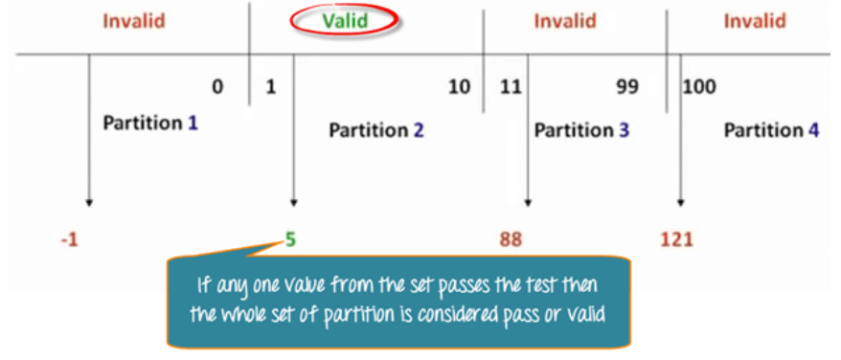
Black Box Testing Equivalence Class Partitioning

Slide 15
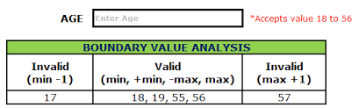
Black Box Testing Boundary Value Analysis
It is used to test boundary values because the input values near the boundary have higher chances of error.

Slide 16
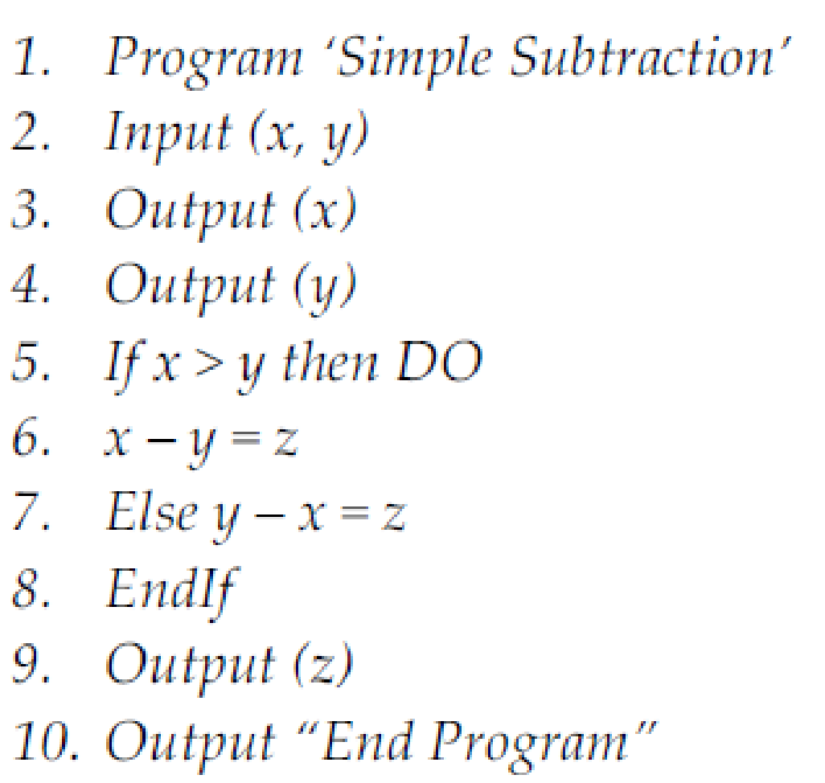
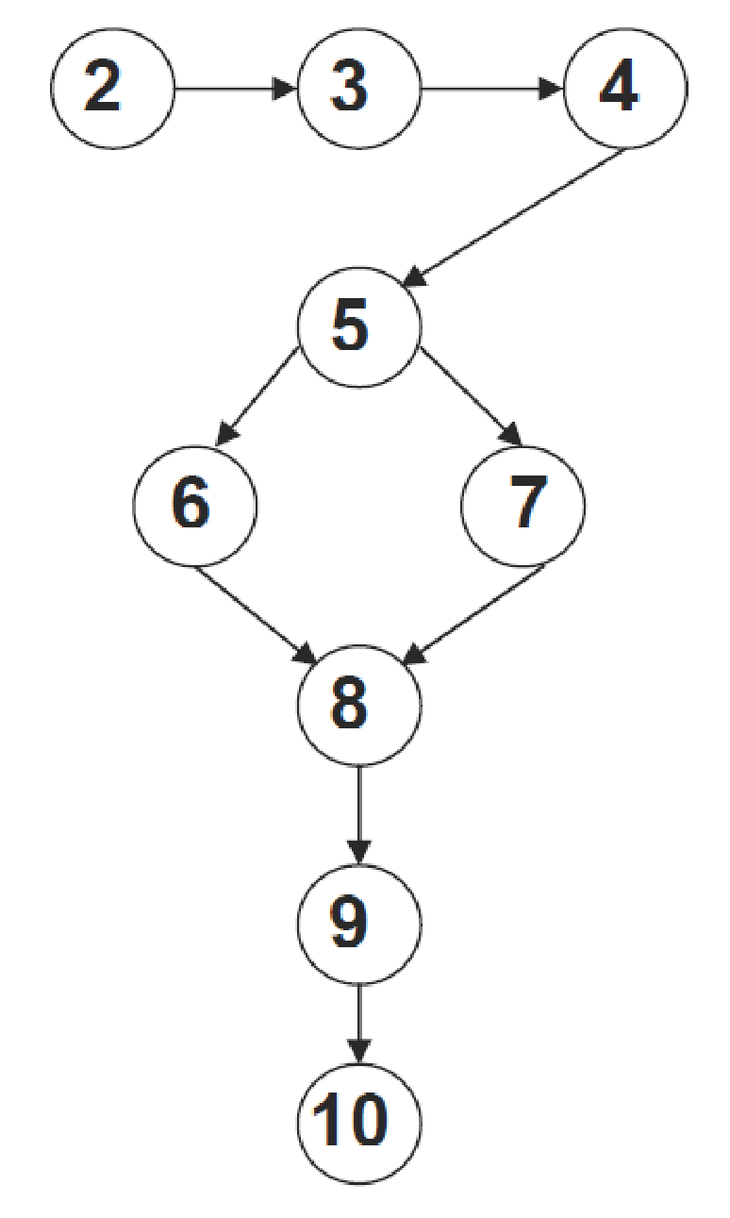
White Box Testing Control Flow Testing
Program
Control Flow Graph
Statement testing
Branch testing
Path testing
…
Notes:
The aim of this technique is to determine the execution paths through a module of program code and then creates and executes test cases to cover those paths.
It is mostly used in unit testing.

Slide 17
White Box Testing Control Flow Testing
Cyclomatic Complexity is the quantitative measure of the number of linearly independent paths in it.
It is a software metric used to describe the complexity of a program.
Complexity is computed as:
Cyclomatic complexity V(G) for a flow graph G is defined as
V(G) = E − N + 2
where E is the number of flow graph edges and N is the number of flow graph nodes.

Slide 18
White Box Testing Control Flow Testing
Cyclomatic Complexity:
V(G) = 9 edges − 9 nodes + 2 = 2.

Slide 19
White Box Testing Control Flow Testing
There are two independent paths:
Path 1: 2-3-4-5-6-8-9-10
Path 2: 2-3-4-5-7-8-9-10

Slide 20
Levels of Testing
Module testing, component testing, or unit testing
Integration testing
System Testing
Function testing
Performance testing
Acceptance testing
Installation testing

Slide 21
Levels of Testing Testing Organization Illustrated

Slide 22
Unit Testing Code Review
Code walkthrough
In a walkthrough, you present your code and accompanying documentation to the review team, and the team comments on their correctness.
Code inspection
In an inspection, the review team checks the code and documentation against a prepared list of concerns. It is more formal.

Slide 23
Unit Testing
Testing the unit for correct functionality
Testing the unit for correct execution

Slide 24
Unit Testing Steps in Testing
Determining test objectives
Selecting test cases
Executing test cases

Slide 25
Unit Testing Whitebox Test Thoroughness
Statement testing: Every statement in the component is executed at least once in some test.
Branch testing: For every decision point in the code, each branch is chosen at least once in some test.
Path testing: Every distinct path through the code is executed at least once in some test.

Slide 26
Example
void Result (int x, int y)
{ int result = x + y;
if (result > 0)
print << “Positive”;
else if (result < 0)
print << “Negative”;
}

Slide 27
Integration Testing
Big-bang
Bottom-up
Top-down
Sandwich testing

Slide 28
Integration Testing Terminology
Component Driver: a routine that calls a particular component and passes a test case to it
Stub: a special-purpose program to simulate the activity of the missing component

Slide 29
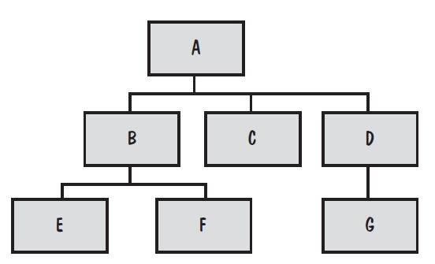
Integration Testing
System viewed as a hierarchy of components

Slide 30
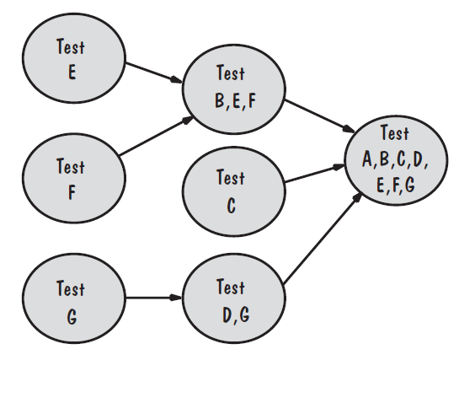
Integration Testing Bottom-Up Integration Example
Drivers are used to call the child functions
Drivers are relatively intelligent
Non-leaves drivers
Locating faults?

Slide 31
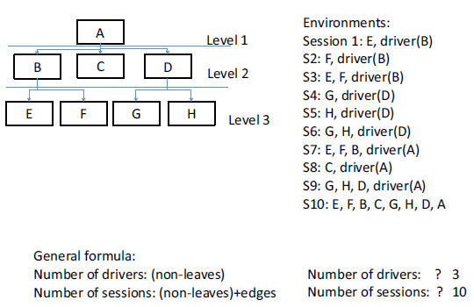
Integration Testing Bottom-Up Integration Example

Slide 32
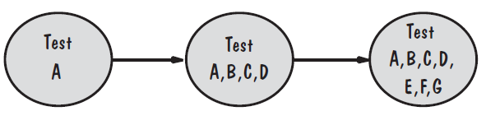
Integration Testing Top-Down Integration Example
Only A is tested by itself
Stubs of B, C and D are used at first level
N-1 stubs required (N=Number of nodes)
Locating faults?

Slide 33
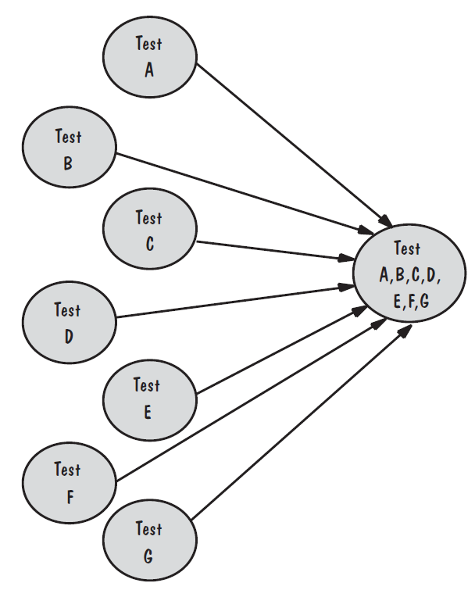
Integration Testing Bing-Bang Integration Example
All components are tested in isolation,
then mixed together as the final system
and evaluated if it works the first time
Requires stubs and drivers
Locating faults?

Slide 34
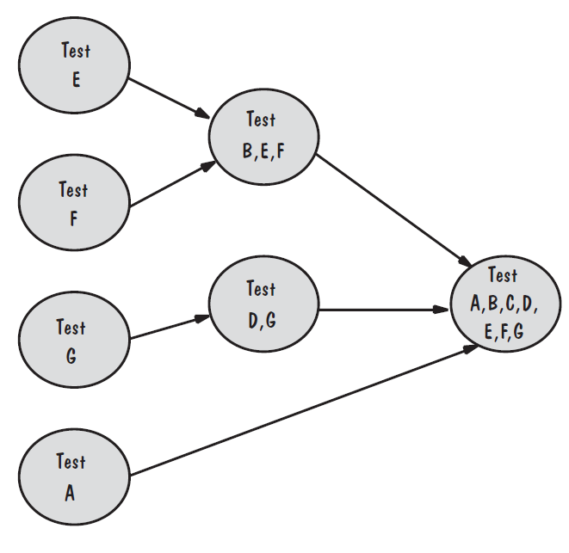
Integration Testing Sandwich Integration Example
Viewed system as three layers
Employ Bottom-Up where
writing drivers is not costly
Employ Top-Down where
stubs are easier to write
Locating faults?

Slide 35
System Testing
System is tested as a whole
Different types of testing considered during System Testing:
- Functional Testing (GUI) - Scalability
- Performance Testing - Sanity
- Usability - Smoke
- Load - Regression
- Volume - Compatibility
- Stress - Installation
- Security - Ad hoc

Slide 36
Steps to do System Testing
The following steps are important to perform System Testing:
Step 1: Create a System Test Plan
Step 2: Create Test Cases
Step 3: Carefully Build Data used as Input for System Testing
Step 3: If applicable create scripts to
- Build environment
- To automate Execution of test cases
Step 4: Execute the test cases
Step 5: Fix the bugs if any and retest the code
Step 6: Repeat the test cycle as necessary

Slide 37
Principles of System Testing Configuration Management
Versions and releases
Regression Testing
Production system vs. development system
Deltas, separate files and conditional compilation
Change control
Notes:
A configuration for a particular system is sometimes called a version. The initial delivery of a software package may consist of several versions, one for each platform or situation in which the software will be used. For example, aircraft software may be built so that version 1 runs on Navy planes, version 2 runs on Air Force planes, and version 3 runs on commercial airliners.
As the software is tested and used, faults are discovered that need correction, or minor enhancements are made to the initial functionality. A new release of the software is an improved system intended to replace the old one.
A production system is a version that has been tested and performs according to only a subset of the customer’s requirements.
The next version, with more features, is developed while users operate the production system. This development system is built and tested; when testing is complete, the development system replaces the production system to become the new production system.
Some development projects prefer to keep separate files for each different version or release.
We need store only the differences, rather than all the components, for each of the other versions. The difference file, called a delta, contains editing commands that describe how the main version is to be transformed to a different version
A third approach to controlling file differences is to use conditional compilation. That is, a single code component addresses all versions. Conditional statements use the compiler to determine which statements apply to which versions.
The configuration management team performs change control. The team oversees the libraries of code and documents, and developers must “check out” copies when making fixes.

Slide 38
Principles of System Testing Regression Testing
Identifies new faults that may have been introduced as current one are being corrected
Verifies a new version or release still performs the same functions in the same manner as an older version or release

Slide 39
Principles of System Testing Regression Testing Steps
Inserting the new code
Testing functions known to be affected by the new code
Testing essential function of m to verify that they still work properly
Continuing function testing m + 1

Slide 40
Acceptance Tests Purpose and Roles
Enable the customers and users to determine if the built system meets their needs and expectations
Written, conducted and evaluated by the customers

Slide 41
Acceptance Tests Types of Acceptance Tests
Pilot test: install on experimental basis
Alpha test: in-house test
Beta test: customer’s pilot
Parallel testing: new system operates in parallel with old system
Notes:
A pilot test installs the system on an experimental basis. Users exercise the system as if it had been installed permanently. Pilot tests rely on the everyday working of the system to test all functions
In parallel testing, the new system operates in parallel with the previous version. The users gradually become accustomed to the new system but continue to use the old one to duplicate the new. This gradual transition allows users to compare and contrast the new system with the old. It also allows skeptical users to build their confidence in the new system by comparing the results obtained with both and verifying that the new system is just as effective and efficient as the old.

Slide 42
Result of Acceptance Tests
List of requirements that
are not satisfied
must be deleted
must be revised
must be added

Slide 43
Installation Testing
Before the testing
Configure the system
Attach proper number and kind of devices
Establish communication with other system
The testing
Regression tests: to verify that the system has been installed properly and works

Slide 44
Software Testing Tools
Automated Testing Tools
Selenium, QTP, SilkTest, WinRunner, LoadRunner, Jmeter
Testing Management Tools
TestManager, TestDirector
Bug Tracking/Configuration Management Tools
Bugzilla, Jitterbug, SilkRadar

Slide 45
When to Stop Testing
No time left
No money left
Statistical Criteria
Number of defects found per week becomes lower than a set threshold

Slide 46
Test Documentation
Test plan: describes system and plan for exercising all functions and characteristics
Test specification and evaluation: details each test and defines criteria for evaluating each feature
Test description: test data and procedures for each test
Test analysis report: results of each test

Slide 47
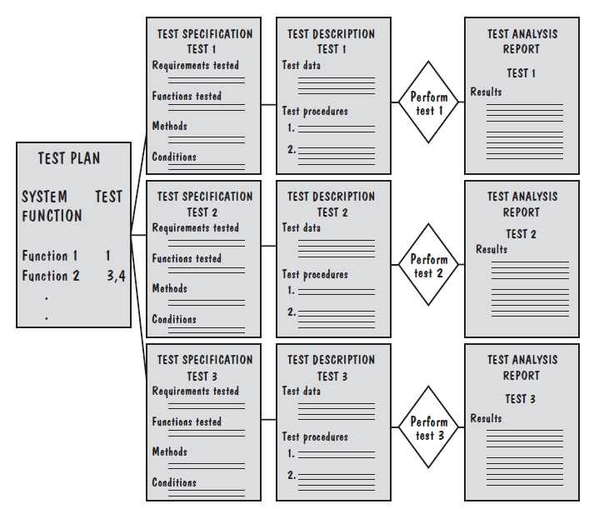
Test Documentation Documents Produced During Testing

Slide 48
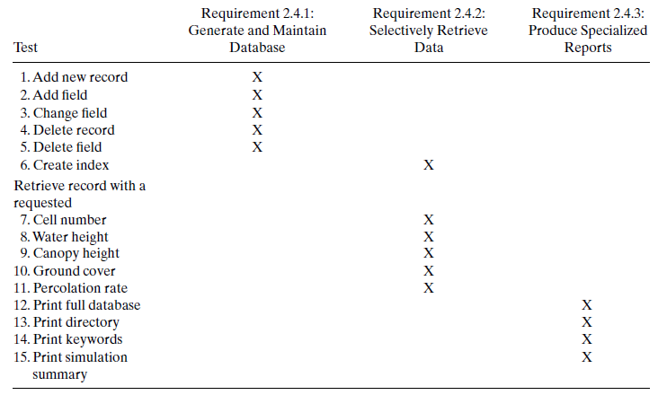
Testing Documentation Test-Requirement Correspondence Chart

Slide 49
Test Documentation Test Description Example
Test data for a test of a SORT routine may be the following:
INPUT DATA:
Input data are to be provided by the LIST program. The program
generates randomly a list of N words of alphanumeric characters;
each word is of length M. The program is invoked by calling
RUN LIST(N,M)in your test driver. The output is placed in global data area LISTBUF. The test datasets to be used for this test are as follows:
Case 1: Use LIST with N=5, M=5
Case 2: Use LIST with N=10, M=5
Case 3: Use LIST with N=15, M=5
Case 4: Use LIST with N=50, M=10
Case 5: Use LIST with N=100, M=10
Case 6: Use LIST with N=150, M=10

Slide 50
Test Documentation Test Description Example
INPUT COMMANDS:
The SORT routine is invoked by using the command
RUN SORT (INBUF,OUTBUF) or
RUN SORT (INBUF)
OUTPUT DATA:
If two parameters are used, the sorted list is placed in OUTBUF.
Otherwise, it is placed in INBUF.
SYSTEM MESSAGES:
During the sorting process, the following message is displayed:
“Sorting...please wait...”
Upon completion, SORT displays the following message on the screen:
“Sorting completed”
To halt or terminate the test before the completion message is
displayed, press CONTROL-C on the keyboard.

Slide 51
Test Documentation Test Script for Testing The “change field”
Step N: Press function key 4: Access data file.
Step N+1: Screen will ask for the name of the date file.
Type ‘sys:test.txt’
Step N+2: Menu will appear, reading
* delete file * modify file * rename file
Place cursor next to ‘modify file’ and press
RETURN key.
Step N+3: Screen will ask for record number. Type ‘4017’.
Step N+4: Screen will fill with data fields for record 4017:
Record number: 4017 X: 0042 Y: 0036
Soil type: clay Percolation: 4 mtrs/hr
Vegetation: kudzu Canopy height: 25 mtrs
Step N+5: Press function key 9: modify
Step N+6: Entries on screen will be highlighted. Move cursor
to VEGETATION field. Type ‘grass’ over ‘kudzu’ and
press RETURN key.
Notes:
A test procedure is often called a test script because it gives us a step-by-step description of how to perform the test.

Slide 52
Test Documentation Test Script for Testing The “change field”
Step N+7: Entries on screen will no longer be highlighted.
VEGETATION field should now read ‘grass’.
Step N+8: Press function key 16: Return to previous screen.
Step N+9: Menu will appear, reading
* delete file * modify file * rename file
To verify that the modification has been recorded, place cursor next to ‘modify file’ and press RETURN key.
Step N+10: Screen will ask for record number. Type ‘4017’.
Step N+11: Screen will fill with data fields for record 4017:
Record number: 4017 X: 0042 Y: 0036
Soil type: clay Percolation: 4 mtrs/hr
Vegetation: grass Canopy height: 25 mtrs
Notes:
A test procedure is often called a test script because it gives us a step-by-step description of how to perform the test.

Slide 53
Test Documentation Test Analysis Report
Documents the result of test
Provides information needed to duplicate the failure and to locate and fix the source of the problem
Provides information necessary to determine if the project is complete
Establish confidence in the system’s performance

Slide 54
Test Documentation Problem Report Forms
Location: Where did the problem occur?
Timing: When did it occur?
Symptom: What was observed?
End result: What were the consequences?
Mechanism: How did it occur?
Cause: Why did it occur?
Severity: How much was the user or business affected?
Cost: How much did it cost?
Notes:
During testing, we capture data about faults and failures in problem report forms.
A discrepancy report form is a problem report that describes occurrences of problems where actual system behaviors or attributes do not match with what we expect. It explains what was expected, what happened, and the circumstances leading to the failure.
A fault report form explains how a fault was found and fixed, often in response to the filing of a discrepancy report form.

Slide 55
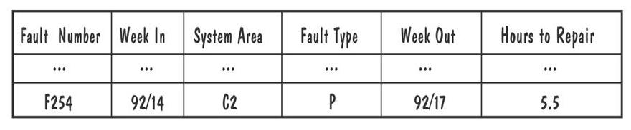
Test Documentation Example of Actual Problem Report Forms

Slide 56
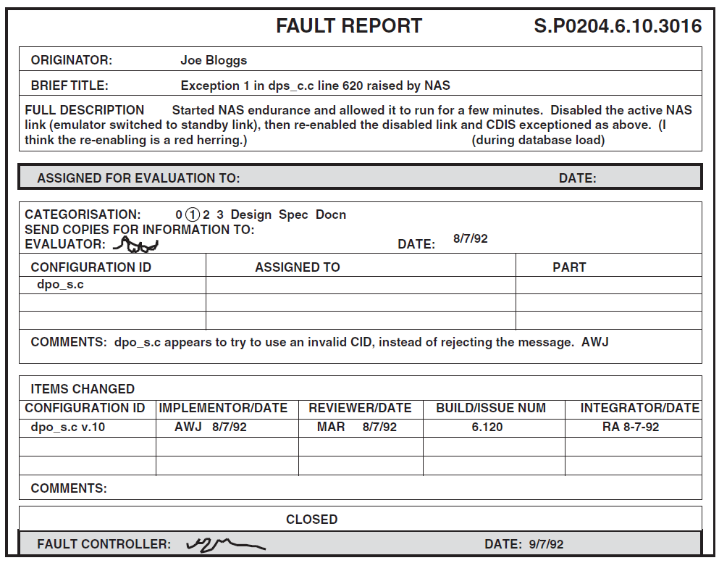
Test Documentation Example of Actual Discrepancy Report Forms
Notes:
A fault report reflects the developer’s understanding of the fault’s impact on the system. A discrepancy report should reflect a user’s view of the failure caused by a fault.

